Slide 1




DATA Management With Hadoop Under the Guidance of Prof. Shraddha Kamble mam
Dr.Babasaheb Ambedkar Technology University’s
Institute of Petrochemical Engineering
Department of Information Technology
Presented by: Sejal Ravindra Pawar
Roll no.:- 2201967
PRN:- 2030408246063
This Photo by Unknown Author is licensed under CC BY-SA-NC

Slide 2
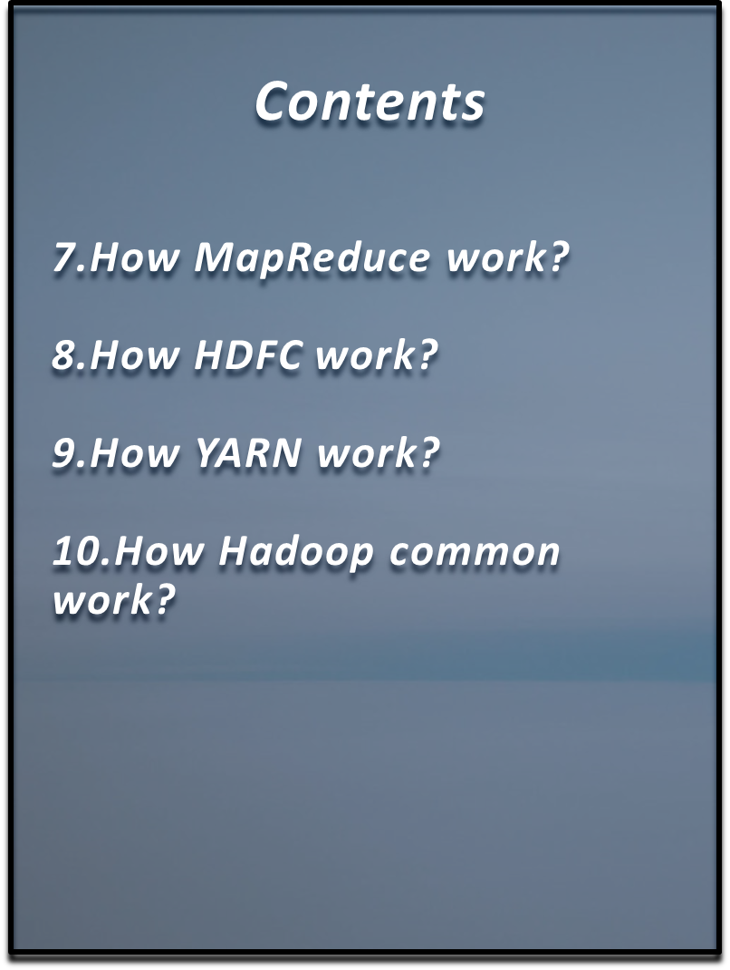
Contents 1.What is HADOOP ?? 2.Why Hadoop ? 3.Developers of Hadoop Technology 4.Famous Hadoop Users 5.Hadoop Features 6.Hadoop Architecture

Slide 3

What is HADOOP??
Data Management with HADOOP
This Photo by Unknown Author is licensed under CC BY

Slide 4

What is Hadoop??
HADOOP is Storage System and Analytics Program Based on Apache.
HADOOP is Open Source Framework that Allow you to stored large amount of data in distributed Environment so you can process it Parallelly.
It is implemented by Java.

Slide 5
What is Big Data??
Data Management with HADOOP
This Photo by Unknown Author is licensed under CC BY

Slide 6

Big Data
Big data is a collection of large datasets that cannot be processed using traditional computing techniques.
It is not a single technique or a tool, rather it has become a complete subject, which involves various tools, techniques and frameworks

Slide 7
What comes under Big data ??
This Photo by Unknown Author is licensed under CC BY

Slide 8


Black Box Data
It is a component of helicopter, airplanes, and jets, etc. It captures voices of the flight crew, recordings of microphones and earphones, and the performance information of the aircraft.
Social Media Data
Social media such as Facebook and Twitter hold information and the views posted by millions of people across the globe.
Stock Exchange Data
The stock exchange data holds information about the ‘buy’ and ‘sell’ decisions made on a share of different companies made by the customers.

Slide 9
Application of Big Data??
Data Management with HADOOP
This Photo by Unknown Author is licensed under CC BY

Slide 10







Slide 11
WHY HADOOP??
Data Management with HADOOP
This Photo by Unknown Author is licensed under CC BY

Slide 12
Why Hadoop ??
Distributed Clusters System.
Platform for Massively Scalable Applications.
Enable parallel data processing.

Slide 13
HISTORY OF HADOOP
Data Management with HADOOP
This Photo by Unknown Author is licensed under CC BY

Slide 14
History of Hadoop
Year | Action taken
2001 | Nutch project was started by Doug cutting and Michael cafarella
2002 | Google released a search paper on Google distributed File System (GFS) that described the architecture for GFS
2004 | Google introduced MapReduce to the world by releasing a paper on MapReduce
2006 | Development of Hadoop started as a sub-project of nutch
2007 | Yahoo started using Hadoop on 1000 nodes cluster.
2008 | Hadoop confirmed its success by becoming the top-level project at Apache.
2011 | Apache released Hadoop version 1.0 that includes support for Security, HBase
2012 | Hadoop 2.0 version which contain YARN was released
2017 | Release 3.0.0 was available
2020 | Hadoop 3.1.3 Latest version of Hadoop released

Slide 15
Developers of Hadoop
Data Management with HADOOP
This Photo by Unknown Author is licensed under CC BY

Slide 16




Developers of Hadoop

Slide 17
Famous Users of Hadoop
Data Management with HADOOP
This Photo by Unknown Author is licensed under CC BY

Slide 18





Slide 19
Features of Hadoop
Data Management with HADOOP
This Photo by Unknown Author is licensed under CC BY

Slide 20
Faster in Data Processing
Open source
Fault Tolerance
Highly Scalable cluster
Easy to use and low cost

Slide 21
Hadoop Architecture
Data Management with HADOOP
This Photo by Unknown Author is licensed under CC BY

Slide 22


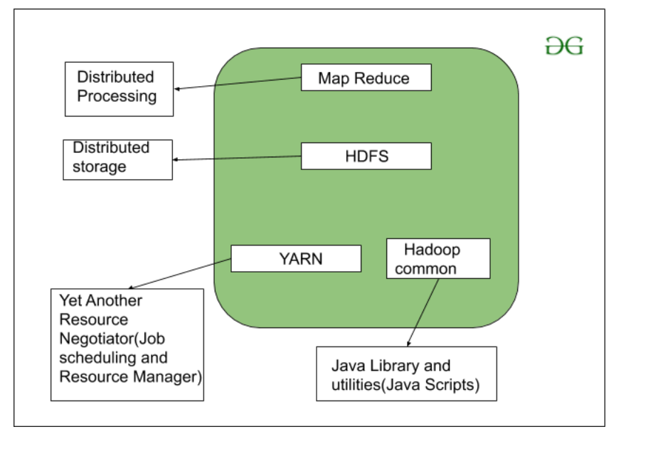
Architecture
Hadoop Architecture contains
Map-Reduce
HDFS
YARN
Hadoop Common

Slide 23
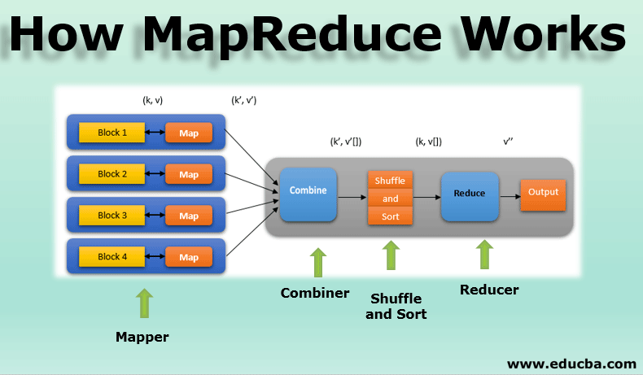
How MapReduce work?
MapReduce facilitates concurrent processing by splitting petabytes of data into smaller chunks, and processing them in parallel on Hadoop commodity servers

Slide 24
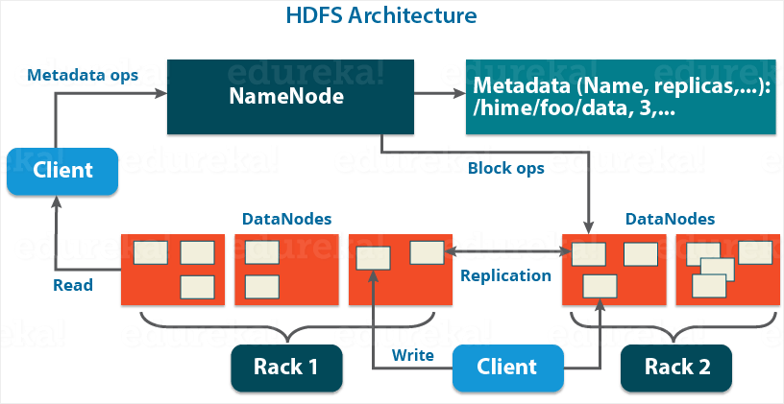
How HDFC Work?
With HDFS, data is written on the server once, and read and reused numerous times after that. HDFS has a primary Name Node, which keeps track of where file data is kept in the cluster. HDFS also has multiple Data Nodes on a commodity hardware cluster -- typically one per node in a cluster.

Slide 25
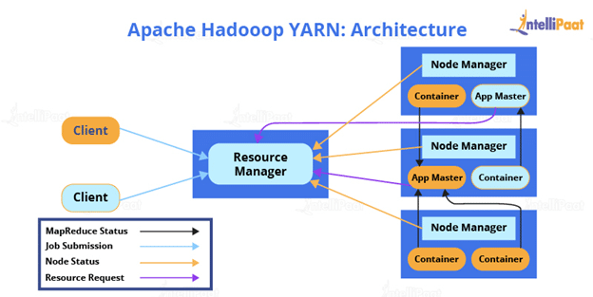
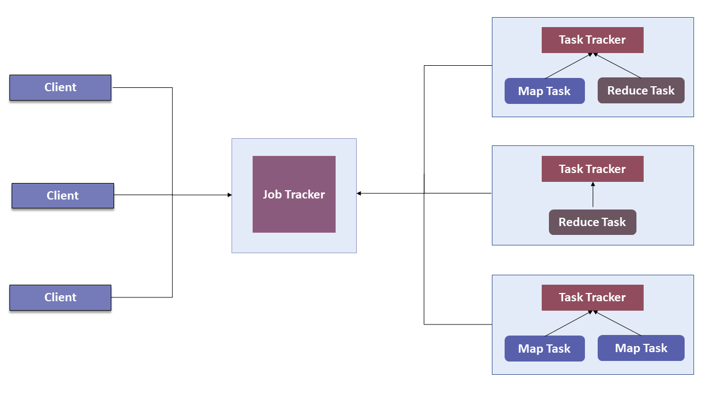
How YARN Work?
YARN helps to open up Hadoop by allowing to process and run data for batch processing, stream processing, interactive processing and graph processing which are stored in HDFS.

Slide 26
How Hadoop common Work?
Utilities(java script)
It provides essential services and basic processes such as abstraction of the underlying operating system and its file system. Hadoop Common also contains the necessary Java Archive (JAR) files and scripts required to start Hadoop..
Hadoop Common
Java libraries

Slide 27
Conclusion
Indeed ,by this seminar I came to know all the concepts of Hadoop, and how it manage, store and process data in distributed Environment. I have also Understood that Now a days we are using Hadoop Technology very much because it allow us to strong big amount of data easily so the companies bank ,social media have used Hadoop technology. I have also learned the concepts of big data and there Applications.
I have understood Hadoop Architecture and how there components like ex YARN,HDFC,Hadoop common,MapReduce etc works. Thus we need Hadoop technology very much for strong big amount of data
This Photo by Unknown Author is licensed under CC BY

Slide 28

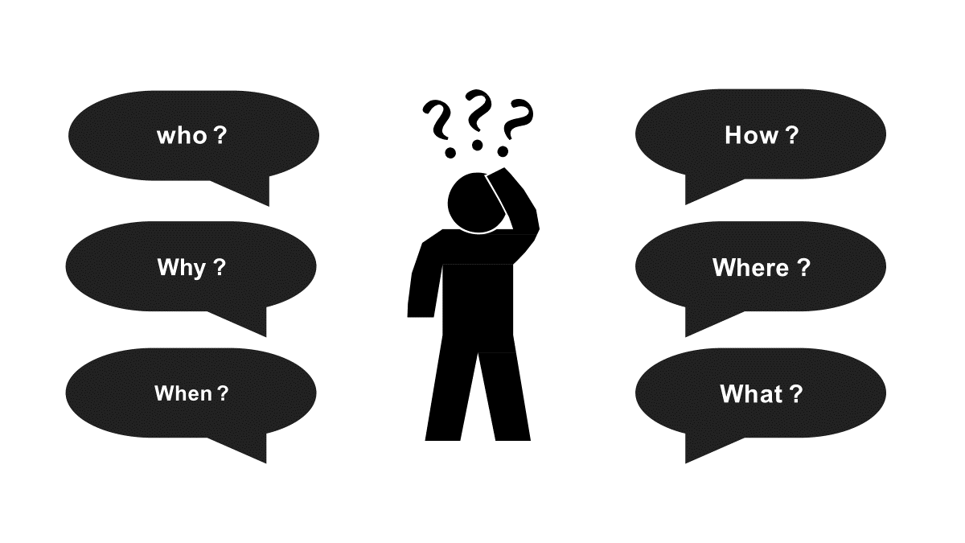
Data Management with HADOOP

Slide 29

Data Management with HADOOP

